Slide 1
4- Code Editors

Slide 2
context
Where type Python code? 3
What is IDE? And it’s feature 4
Popular Code Editors and IDEs 5
what will we use? 6

Slide 3
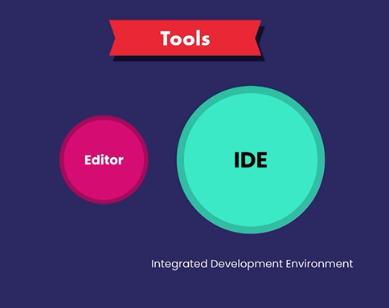
Where type Python code?
code editor
Integrated Development Environment (IDE)

Slide 4
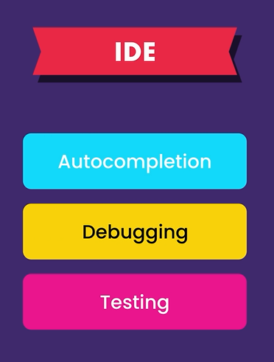
IDE
An IDE is basically a code editor with some fancy features like:
autocompletion
as you type code this feature helps you complete your code, so you don't have to type every character by hand.
It's a productivity boosting feature.
Debugging
finding and fixing bugs in your programs
Testing
and so on

Slide 5
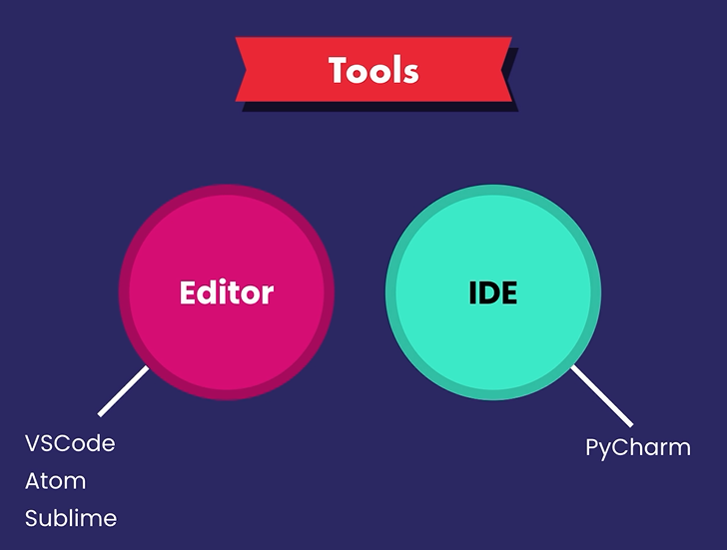
Popular Code Editors and IDEs
Code Editors
VS code,
Atom,
Sublime.
IDEs
Pycharm.

Slide 6
what will we use?
Visual Studio Code (VSCode)
Code.visualstudio.com
I will show you how to install a plugin or an extension that will convert vs code into a powerful IDE.

